Slide 1
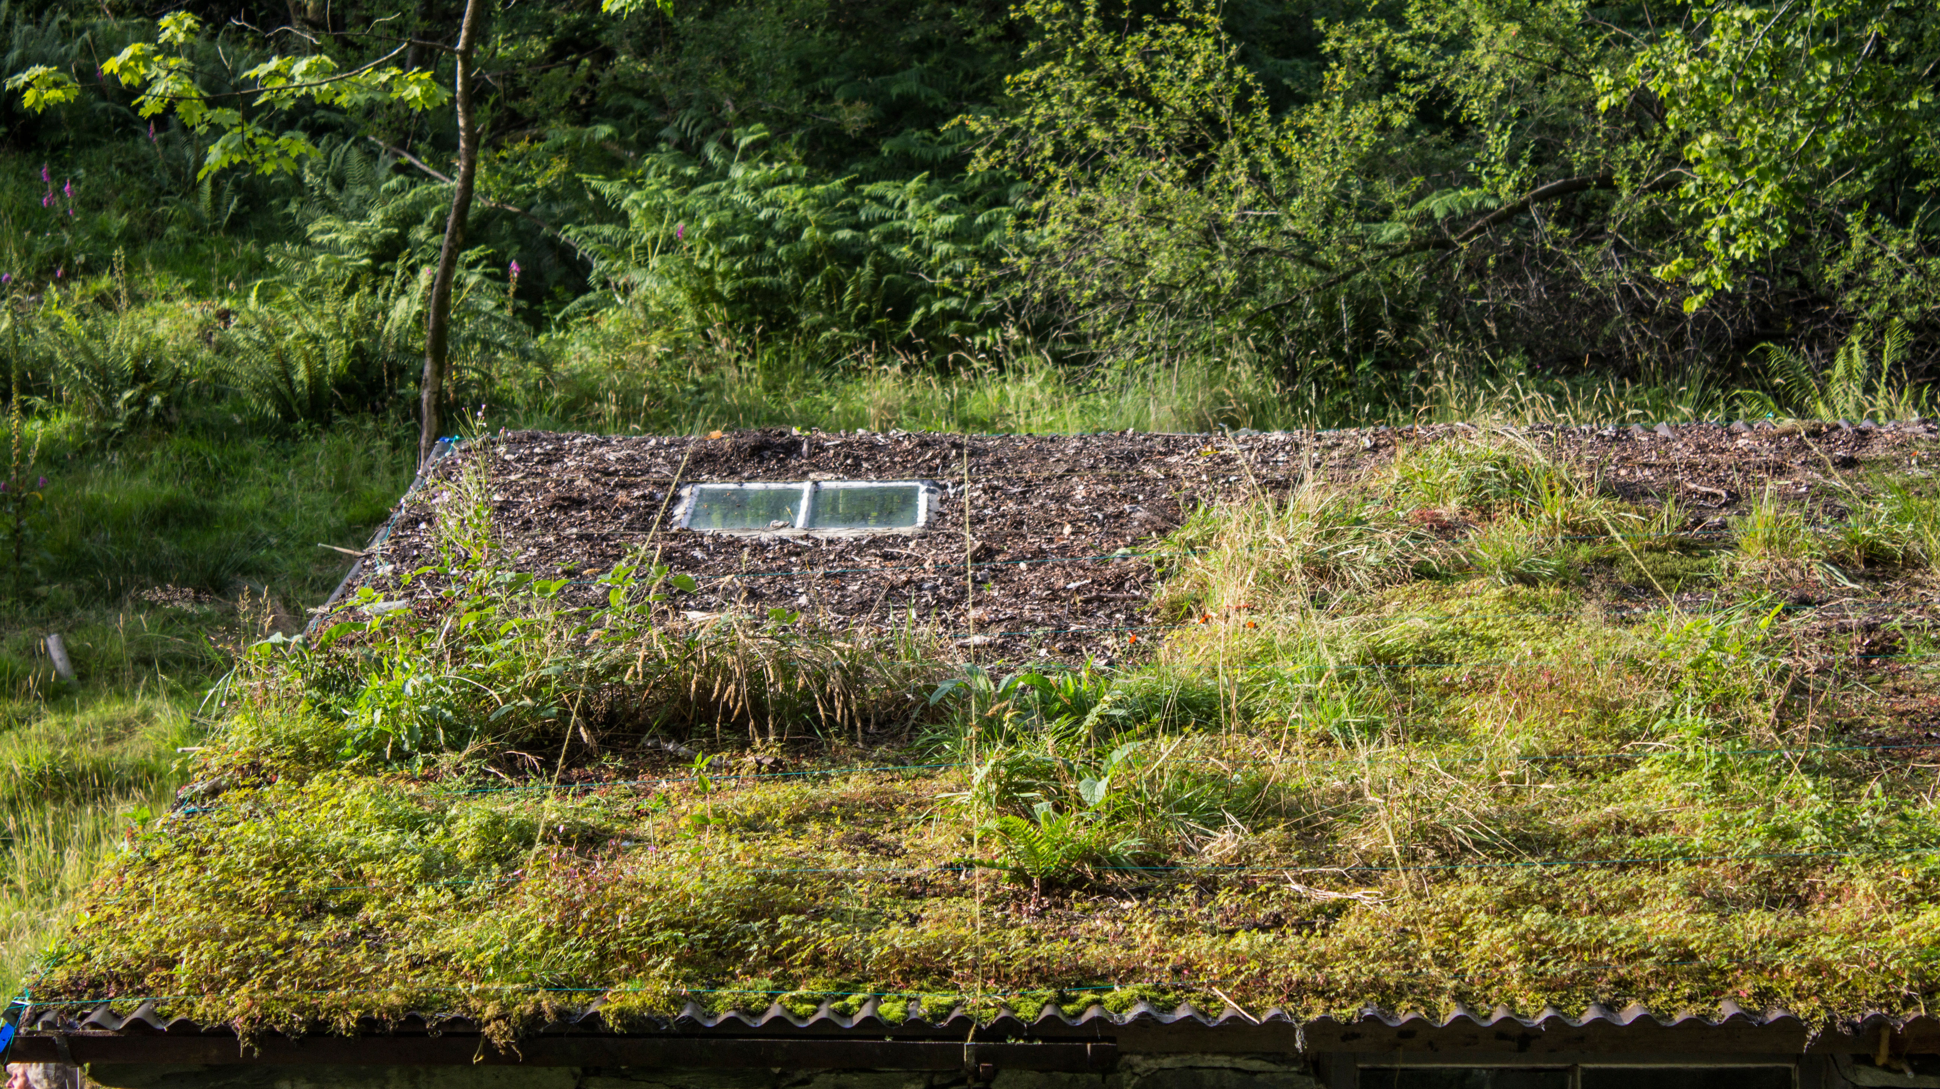
Writing workshop
Merz barn Residency, Ana Carolina Rodrigues, 2017

Slide 2
Icebreaker write without stopping for 5 min

Slide 3
Choose a paragraph from a piece of text (it can be a stanza of a poem, a chorus of a song, a paragraph from book, a sentence from a review). It can be from a book you are reading now; from an exhibition you saw last week, etc.
You start by copying exactly what is written and then you continue what´s written in the same style, the same tense with the idea of incorporating your interests.

Slide 4
Describe a work that you have in your studio?

Slide 5
Evocation of Buked, Shawanda Corbett, 2018, performance commissioned by Deptford X. Photo: Marcia Chandra.
Please take notes on words that are interesting to you
“Corbett refers to herself as a ‘cyborg’ artist"... "for Corbett (her love of sci-fi aside), it refers to anything mechanical that can enhance human life. ‘It came about when I read Donna Haraway’s Cyborg Manifesto (1985). I wanted to use [the book] but with my perspective: a Black woman, queer, disabled and all these other social identities that I have, whether decided or decided for me,’ says the artist, who was born with one arm and without legs. ‘Terminology around disability or anything like that has such a heavy history to it. And it’s something that I don’t necessarily identify with. I would prefer to be called a cyborg.’”
Shawanda Corbett on breaking the mould of ceramic art, Wallpaper

Slide 6
Please take notes on words that are interesting to you.
Installation view of Shawanda Corbett: Neighbourhood Garden, Corvi-Mora. Photo: Marcus Leith, courtesy the artist and Corvi-Mora, London
"‘The vessels are stand-ins for people. They are just like bodies: that’s why there are different shapes, colours and layers to all of them.’ Each is inspired by a real person, remembered from the various neighbourhoods – mostly low-income, predominately home to people of colour – that Corbett has lived in for most of her life in New York and the American South."
Shawanda Corbett on breaking the mould of ceramic art, Wallpaper

Slide 7
Marguerite Humeau’s installation Levitation
"It is reminiscent of the decoration of a luxury hotel and the profusion of overproduction. The plants reflect a way of life in which nature serves only as an artifice. Behind this lush beauty lies disgust and physical discomfort. These plants refer to infection. The lungwort treats lung infections, the liverwort treats liver diseases and the herb-Robert geranium acts on fluids and blood vessels. The plants are placed on an irregular and undulating shape which reminds us that human activity often disrupts the earth’s breathing, which causes it to become threatening."
© Julia Andréone. Lévitation, Marguerite Humeau, Lafayette Anticipations – Fondation Galeries Lafayette

Slide 8
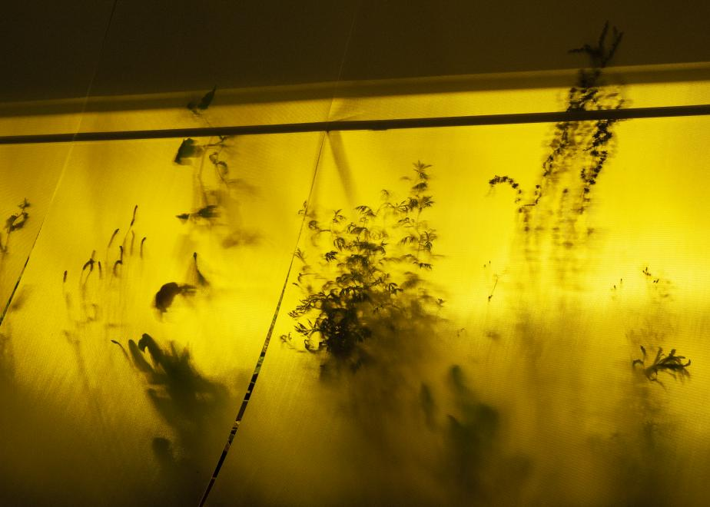
"What if we were able to read the many signs indicating the end of the world?
Some weeds can predict soils’ impoverishment due to the effect of climate change and chemical processes we force upon them. They are housed here in Marguerite Humeau’s greenhouse. In this giant crystal ball, the vision of a possible drought is endlessly reflected. The powers of vegetation—the annual mercury plant signals soil erosion, broad-leaved dock reveals heavy metals—combine with the gifts of a clairvoyant who also lives in this greenhouse. They develop sensory abilities identical to those of plants, such as anticipation and empathy, but also prescience for worlds to come."
"
The Desert Oracles, Marguerite Humeau, Lafayette Anticipations – Fondation Galeries Lafayette

Slide 9
The Desert Oracles, Marguerite Humeau, Lafayette Anticipations – Fondation Galeries Lafayette

Slide 10
"´Anemine` is a substance based on ancient and abundant natural properties found in the Amazon. The molecular structure of chlorocruorin (green blood), which comes from annelids found in the rainforest, was synthesized and has been turned into a lacteal green distillate. Enhancing the intensity of human perception the substance’s impact echoes throughout the gallery’s spaces as a simulation of its own effects.
The exhibition’s light installation, which runs along the tracks of the gallery’s lighting system, is comprised of pure RGB green and blue projected onto the floor of the main spaces. It renders an artificial ambiance of light radiating through trees and plant leafage, water and skies. The image it produces is like a translation of the aerial view of the rainforest’s green vegetation and the blue water of the Amazon river’s serpentine movement." Pamela Rosenkranz, Anemine, Miguel Abreu Gallery
Anemine
Miguel Abreu Gallery, New York, 2016
Installation view

Slide 11
Anemine
Miguel Abreu Gallery, New York, 2016
Installation view

Slide 12
session aims
• map your practice and writing

Slide 13
I am interested ...themes, ideas.

Slide 14
Why... because (personal story)...

Slide 15
I am making/ creating... drawings, objects, formats, performances, sculptures

Slide 16
In my writing I am exploring … ( art works or practices, texts <theoretical, art criticism and/or literary>, objects and any other relevant cultural phenomena that might include, for example, film or music)

Slide 17
I will definitely want to include in my writing … ( a work seen in an exhibition or elsewhere sited, an event experienced, or an original text read rather than a secondary interpretation by someone else)

Slide 18
So, I can explore ... (concepts, questions that your work raise to you that are related to)

Slide 19
I am interested ...themes, ideas.
Why... because (personal story)
I am making/ creating... drawings, objects, formats, performances, sculptures
In my writing I am exploring … ( art works or practices, texts <theoretical, art criticism and/or literary>, objects and any other relevant cultural phenomena that might include, for example, film or music)
I will definitely want to include in my writing … ( a work seen in an exhibition or elsewhere sited, an event experienced, or an original text read rather than a secondary interpretation by someone else)
So, I can explore ... (concepts, questions that your work raise to you that are related to)

